Slide 1

Python Implementations
Reza Shalbafzadeh
Tehran Python User Group

Slide 2
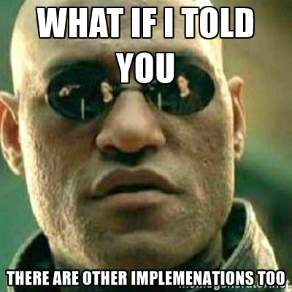

Slide 3

Python is an interpreted language
Python code wont run directly on computer
It need a VM to run

Slide 4
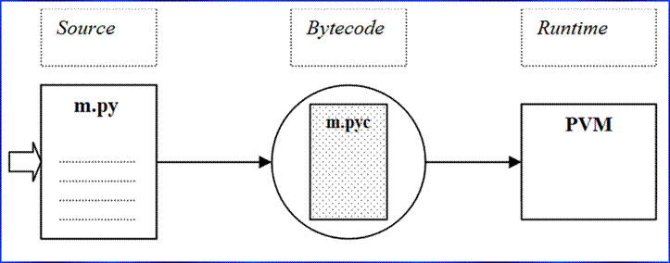

Slide 5
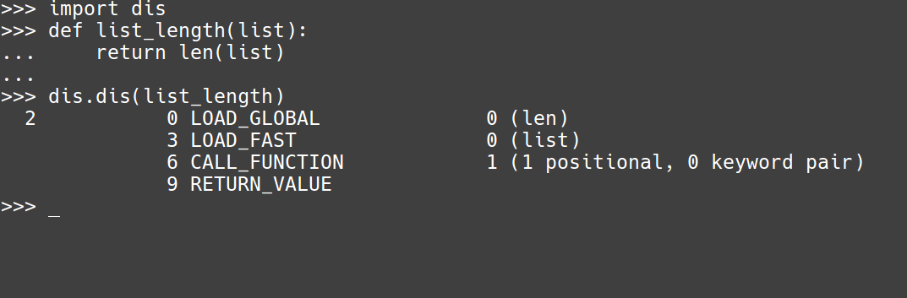
Byte code ? WAT?

Slide 6
Main implementaion : CPython!
Written in C (C89)
Mostly when we talk about Python, it’s Cpython
Has a large standard library built via C and Python
Currently is on version 2.7 and 3.6
2.7 is going to die in 2 years!

Slide 7


Slide 8
Cpython is written in C
Which means
You can implement this VM with other languages too!

Slide 9
So we have ...
Jython
IronPython
PyPy
MicroPython

Slide 10
Jython
Built upon JVM
compiles Python code to Java bytecode which is then executed by the JVM
it is able to import and use any Java class like a Python module
C extensions wont work (lxml)
Jython currently supports up to Python 2.7

Slide 11
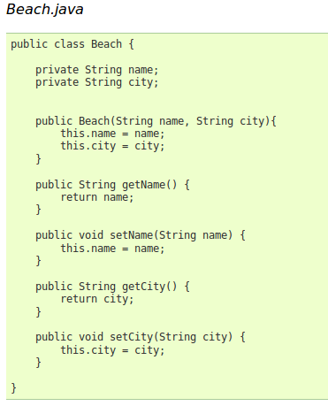
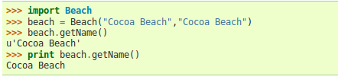

Slide 12


Slide 13
TIL : JIT
Just In Time Compilation
Profile Code as it runs and optimizes bytecode
it’s a broaaaadddd Topic

Slide 14
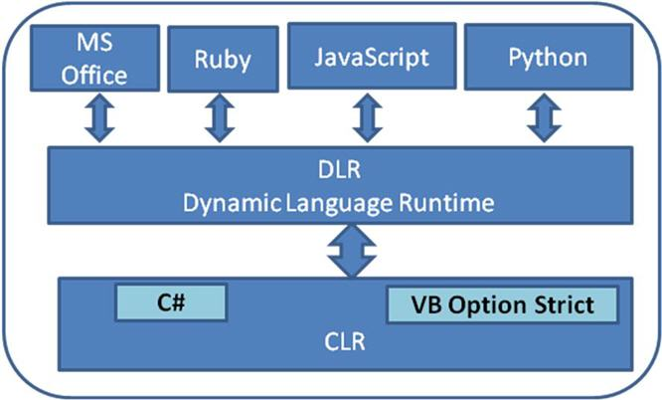
IronPython
Just like Jython but built via .Net
Written in C#
Started by Microsoft , lately abandoned
Works on top of DLR witch itself is built on top of CLR

Slide 15


Slide 16
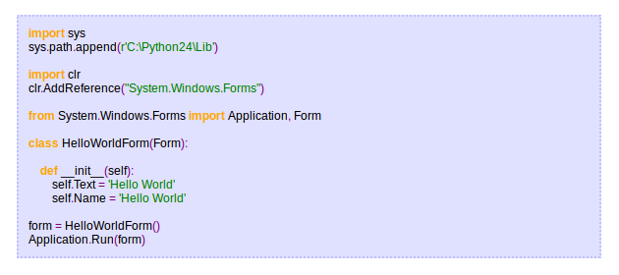
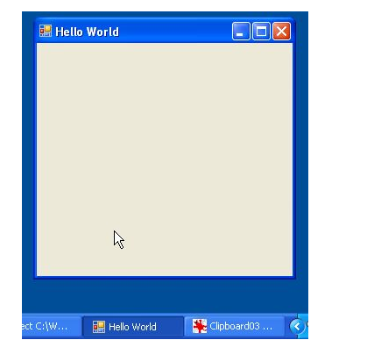
How it works ?

Slide 17
PyPy
Written in RPython ( restricted version of Python)
Supports Python2.7 and 3.3
Most promising Interpreter after CPython

Slide 18


Slide 19
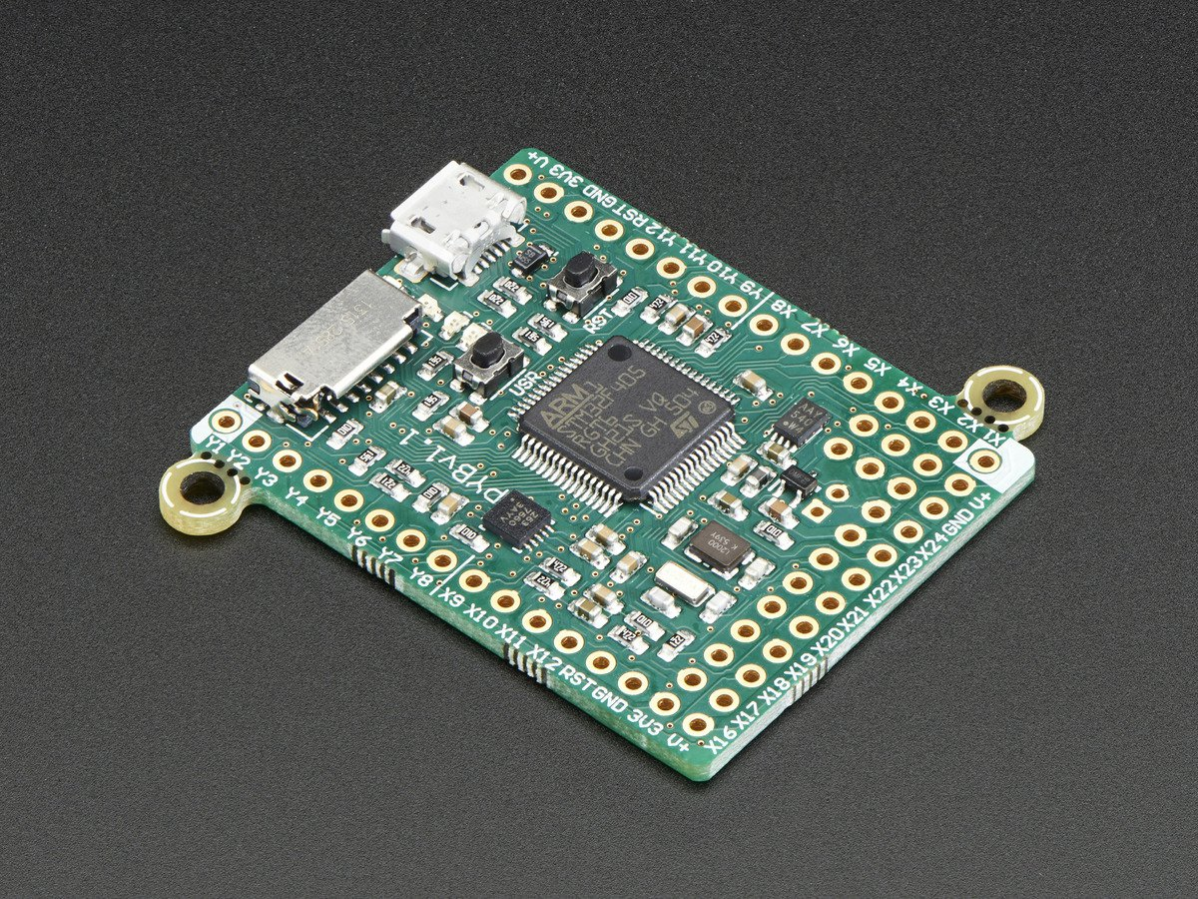
MicroPython
Targets Python 3 ( yaayyyy)
Aimed for Micro Controllers
Implements a small subset of Standard Library
Designed for a specific hardware

Slide 20
Any Questions?
I have answers (hopefully)

Slide 21
Thank ...
You!
My friends who helped my for preparing this

